Slide 1
CARES Act Update for Tribes and TDHEs PIH Notice 2020-05 (CARES Act Waiver Notice) April 17, 2020

Slide 2
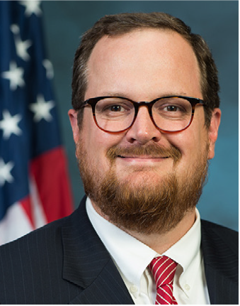
Hunter Kurtz
Assistant Secretary
Office of Public and Indian Housing

Slide 3
Agenda
Background on PIH Notice 2020-05
Review waivers and alternative requirements that apply to Office of Native American Programs (ONAP).
Q&A
Notes:
Hunter

Slide 4
The CARES Act
The President signed the Coronavirus Aid, Relief, and Economic Security (CARES) Act, into law on March 27, 2020
Provides broad waiver authority and flexibilities, to allow PIH and our partners to continue the mission of providing decent, safe, and affordable housing
Implemented through PIH Notice 2020-05 published on April 10, 2020
Provides additional funding to HUD to prevent, prepare for, and respond to the national impacts of the coronavirus pandemic
Future PIH Notices will provide information on supplemental funding
Notes:
Hunter

Slide 5
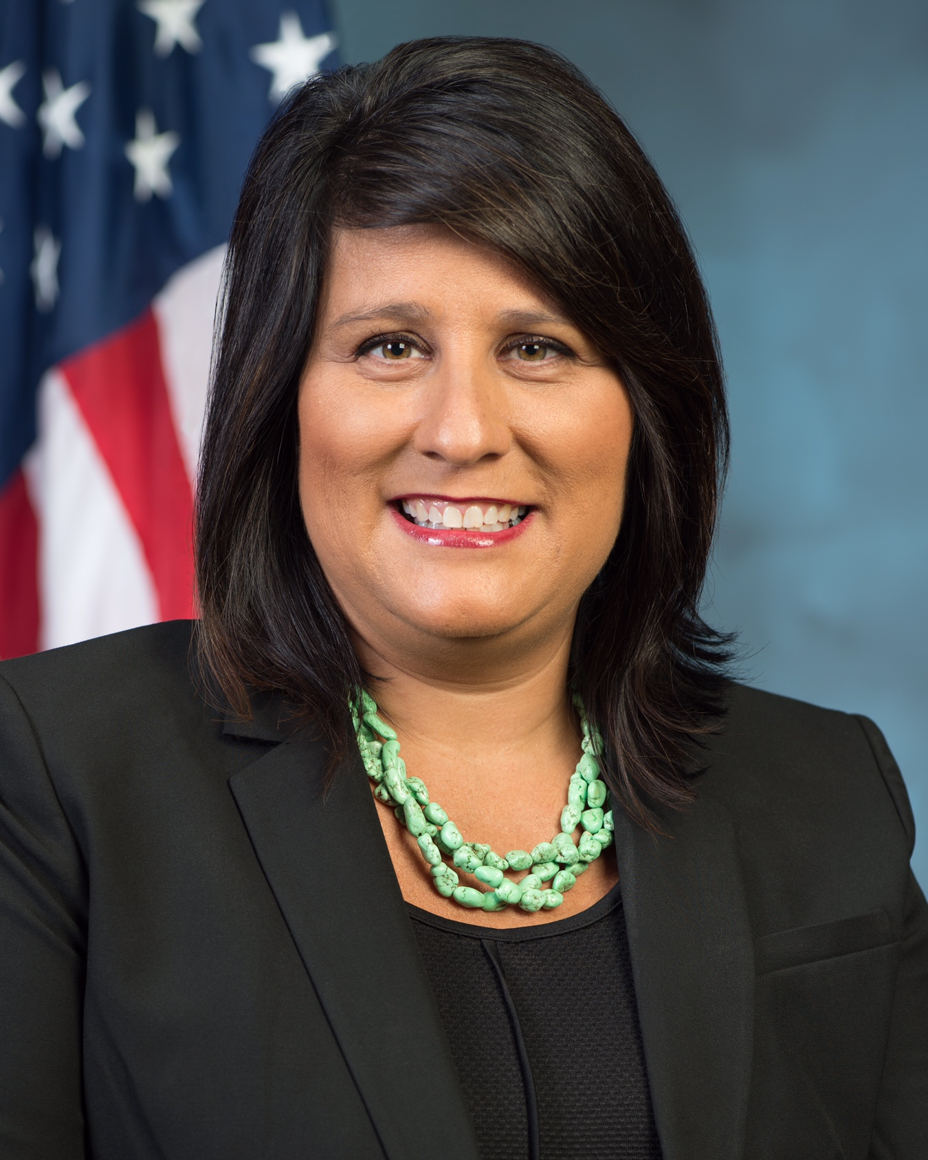
Heidi Frechette
Deputy Assistant Secretary
Office of Native American Programs

Slide 6
CARES Act: ONAP
Purpose: to help Tribes and Tribally Designated Housing Entities (TDHEs) prevent, prepare for, and respond to the national impacts of the coronavirus pandemic
Funding: $300 million for two ONAP programs
$200 million for the Indian Housing Block Grant (IHBG) program
$100 million for the Indian Community Development Block Grant (ICDBG) program (Imminent Threat)
Waivers and Flexibility: provides broad waiver authority and flexibility with funds provided in the CARES Act, as well as IHBG formula and ICDBG funds awarded in FY 2020.

Slide 7
Waivers | Guiding Principles
Maintain health and safety of TDHE residents and staff while allowing for maximum flexibility
Extend relief quickly so Tribes and TDHEs can continue operations to the extent possible.
Clarifying or additional guidance or waivers may be necessary. Timeframes may be extended.
Address most requested waivers from FAQ mailbox, conference calls, prior disaster experience.
Notes:
Hunter

Slide 8
CARES Act Waiver Notice
Jad Atallah
Director, Office of Performance and Planning
Office of Native American Programs

Slide 9
Waiver Authority and Flexibilities provided to the:
Indian Housing Block Grant program
Indian Community Development Block Grant program

Slide 10
Indian Housing Block Grant
Application Process: (Section 101(b), Section 102, and Section 103 of NAHASDA; 24 C.F.R. §§ 1000.214; 1000.218;1000.220; 1000.224; 1000.226; 1000.228;1000.230; and 1000.232)
Indian Housing Plan (IHP): ONAP will accept an abbreviated IHP for funds received from the CARE Act (further guidance coming)
Recipients: Tribes and TDHEs that did not submit an IHP or were not approved for FY 2020 are still eligible for CARES Act funding as long as they submit one at this time
Reprogramming funds: Recipients can reprogram their FY 2020 IHBG grants (that are already dispersed and available) in order to help address COVID-19
Certification: Tribes are not required to do this if it is not practical or safe to obtain due to COVID-19

Slide 11
Indian Housing Block Grant
Indian Housing Plan (IHP)
Regulations: Section 101(b) and 102(a) of NAHASDA; 24 CFR §§ 1000.214, 1000.216, 1000.225
Submission Deadlines: Recipients with due dates in January 2020 and April 2020 can now submit them in October 2020
Annual Performance Report (APR)
Regulations: Sections 403 and 404 of NAHASDA; 24 CFR § 1000.514
Submission Deadlines:
Recipients with a due date in March 2020 can now submit them in June 2020
Recipients with a due date in June 2020 can now submit them in September 2020
Income Verification
Regulations: 24 CFR § 1000.128
Alternative requirements:
Allow recipients to deviate from written admission and occupancy polices to verify income less frequently.
Allow recipients to carry out intake and other tasks remotely

Slide 12
Indian Housing Block Grant
Public Health Services
Regulations: Section 202(3) of NAHASDA
Alternative requirements: allow funds to be used to carry out a wide range of public health services under this category of eligible activities
Eligible uses include:
providing testing, diagnosis, and other related services to residents
establishing a fixed or mobile location to conduct testing and treatment
paying for necessary equipment, supplies, and materials, including personal protective equipment
Delivering meals and food to those sheltering in place

Slide 13
Indian Housing Block Grant
Assistance to Non-Low Income and Non-Native Families
Regulations: Section 201(b) of NAHASDA; 24 CFR §§ 1000.104, 1000.106, 1000.108, 1000.110; 1000.312, 1000.314, 1000.318
Alternative requirements: established under the understanding that otherwise ineligible families are being assisted in order prevent the spread of COVID-19
Eligible uses include:
temporarily housing any individuals, regardless of Indian status or income level in tribally owned units or privately owned units
providing masks, medical testing kits, food preparation, and cleaning/decontamination

Slide 14
Indian Housing Block Grant
Useful Life
Regulations: Section 205 of NAHASDA; 24 CFR §§ 1000.141, 1000.142, 1000.143, 1000.144, 1000.146, 1000.147
Requirements: Affordability and useful determination not required at this time
Eligible uses include: cleaning up units or using units as temporary housing during the COVID-19 outbreak
Total Development Costs
Regulations: 24 CFR §§ 1000.156, 1000.158, 1000.160, 1000.162
Requirements:
HUD is waiving the requirements relating to limitations on cost or design standards and TDC with respect to dwelling and non-dwelling units
Recipient may exceed the current TDC maximum by 20 percent without HUD review or approval, and exceed 20 percent with HUD approval
Must be for purpose of to prevent, prepare for, and respond to COVID-19

Slide 15
Indian Housing Block Grant
Prohibition Against Investment of CARES Act Grant Funds
Regulations: Section 204(b) of NAHASDA; 24 CFR § 1000.58
Requirements: HUD is prohibiting the investment of any IHBG funding provided under the CARES Act

Slide 16
Indian Community Development Block Grant
Citizen Participation
Regulations: Section 104 of the Housing and Community Development Act of 1974 (HCD Act); 24 CFR §§ 1003.604,1003.305(b)(3)
Waivers: Considering COVID-19-related social distancing directives, and other prohibitions against large in-person gatherings, in person citizen meetings are not advised. Accordingly, HUD is waiving 24 CFR § 1003.604(a)(2) and 24 CFR § 1003.305(b)(3), and will not require Indian Tribes to hold one or more meetings to obtain the views of residents before applying for ICDBG-CARES grant funding or amending their FY 2020 ICDBG grants to address COVID-19.
Planned use of funds: Indian Tribes will continue to be required, however, to meet the citizen participation requirements by publishing or posting information on their plans to use ICDBG grants, and accepting and considering comments, to the extent the Indian tribe determines that that can be done without subjecting residents to unnecessary risks to health and safety.

Slide 17
Indian Community Development Block Grant
Application Process
Regulations: 24 CFR §§ 1003.400, 1003.401, 1003.402; Section I.A.1.b. of the combined FY 2019/2020 ICDBG Notice of Funding Availability (NOFA)
ONAP will issue new updated application guidance soon for ICDBG-CARES grants and FY 2020 ICDBG Imminent Threat grants to address the COVID-19 crisis.
Applicants won’t be required to demonstrate that COVID-19 is a non-reoccurring imminent threat and that it has an impact on an entire service area.
For ICDBG-CARES grants, HUD is waiving the current ICDBG Imminent Threat grant ceilings.
HUD will publish an ICDBG-CARES Implementation Notice in the very near future and establish grant ceilings in that notice.
Any previous costs associated with preventing, preparing, or responding to COVID-19 incurred by an ICDBG applicant or grantee before the enactment of the Act may be reimbursed with ICDBG-CARES grant funding.
HUD is waiving the letter to proceed provision in 24 CFR § 1003.401(a)
HUD is waiving 24 CFR § 1003.402 which provides that if any reserved funds are not used to fund imminent threat grants during a fiscal year, they will be added to the allocation of ICDBG funds for the subsequent fiscal year and will be used as if they were a part of the new allocation.

Slide 18
Indian Community Development Block Grant
Removal of Public Services 15 Percent Cap under FY 2020 ICDBG Grants
Regulations: Section 105 of HCD Act 24 CFR § 1003.201(e); FY 2019/2020 ICDBG NOFA)
Waivers: HUD is waiving Section 105 of the HCD Act, 24 CFR § 1003.201(e), and language in the definition of the term “public services” in the FY 2019/2020 ICDBG NOFA to the extent necessary to remove the 15 percent cap on FY 2020 ICDBG funding (both Single Purpose and Imminent Threat grants), to align with ICDBG Imminent Threat funding provided under the CARES Act.
Compliance with 24 CFR § 1003.305: ICDBG grantees that have been awarded FY 2020 ICDBG funds are reminded that they must still comply with the provisions of 24 CFR § 1003.305 if they are seeking to amend their grants to carry out additional public services or other activities to prevent, prepare for, or respond to COVID-19

Slide 19
Indian Community Development Block Grant
Rental Assistance, Utility Assistance, Food, Clothing, and Other Emergency Assistance
Regulations: Section 105 of the HCD Act.; Regulatory Authority: 24 CFR § 1003.207(b)(4)
Waivers: To help Tribal communities address these challenges, HUD is waiving Section 105(a)(8) and 24 CFR § 1003.207(b)(4) to the extent necessary to establish the following alternative requirement:
ICDBG grant funds may be used to provide emergency payments for low- and moderate-income individuals or families impacted by COVID-19 for items such as food, medicine, clothing, and other necessities, as well as rental assistance and utility payment assistance, without regard for the 3-month limitation in 24 CFR § 1003.207(b)(4), but for a period not to exceed six months unless further expanded by HUD at a later date.
Emergency payments: these emergency payments must be used to either cover costs incurred directly by the ICDBG grantee in cases where the ICDBG grantee is providing this assistance, or made directly to a third-party provider of such items or services on behalf of an individual or family, and may not be paid directly to an individual or family in the form of income payments, debit cards, or similar direct income payments
Documentation: ICDBG grantees using this alternative requirement must document, in its policies and procedures

Slide 20
Indian Community Development Block Grant
Purchase of Equipment
Regulations: 24 CFR §§ 1003.207(b)(1); 1003.201(c)(1)(ii)
Waivers: HUD is waiving 24 CFR § 1003.207(b)(1) and authorizing the use of ICDBG funds for the purchase of equipment necessary to prevent, prepare for, and respond to the COVID-19.
Other Federal sources of funding: ICDBG grantees must ensure that ICDBG funds are used to supplement other Federal sources of funding for this purpose, including funding provided by the Indian Health Service, and should not be used to supplant such funding.

Slide 21
Indian Community Development Block Grant
Operating Expenses for Public Facilities
Regulations: 24 CFR § 1003.207(b)(2)
Waivers: HUD is waiving 24 CFR § 1003.207(b)(2) to the extent necessary to allow the use of ICDBG funds to pay for such operating and maintenance expenses of any public facility, to the extent it is used for COVID-19-related purposes.
Prohibitions: In incurring such costs, ICDBG grantees may not use this waiver to pay for associated staffing costs of such public facilities.
Other Federal sources of funding: ICDBG grantees must also ensure that ICDBG funds are used to supplement other Federal sources of funding for this purpose, including funding provided by the Indian Health Service, and should not be used to supplant such funding.

Slide 22
Indian Community Development Block Grant
New Housing Construction by Tribe
Regulations: Section 105 of the HCD Act, 24 CFR § 1003.207(b)(3)
Waivers: HUD is waiving and modifying Section 105 of the HCD Act and 24 CFR 1003.207(b)(3) to the extent necessary to provide for the following alternative requirement: Indian tribes and tribal organizations may use ICDBG funds to carry out new housing construction when such construction is carried out to reduce overcrowding, or to otherwise prevent, prepare for, or respond to COVID-19.
Assessing applications: When assessing applications for ICDBG-CARES grants that propose to carry out new housing construction, HUD will only fund applications that propose to carry out new housing construction that is clearly designed to prevent, prepare for, and respond to COVID-19, and that the applicant plans to carry out expeditiously

Slide 23
Questions, Comments, Concerns, Suggestions? Chat Feature

Slide 24
Thank you for joining today’s call.
Please email any additional questions to CodeTalk@hud.gov
Reminder: Visit www.HUD.gov/coronavirus for the latest COVID-19 resources.
Notes:
Dominique

